Slide 1
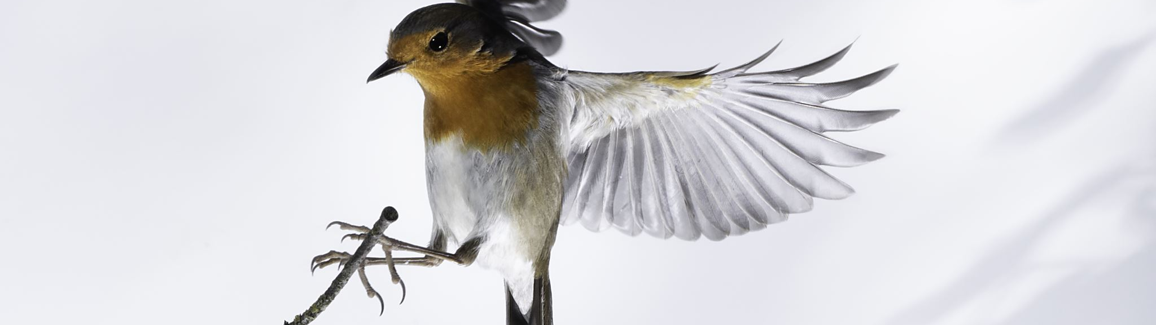
Classifying Bird Species With Image Recognition
Brendon Bottle
And
Sean McManus

Slide 2
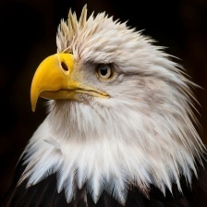
Problem Description
Project goal is to classify images of birds into the correct species
A potential use case is evaluating the number of remaining birds in an endangered species through drone images
Focus was on building a convolutional neural network optimized for image classification

Slide 3
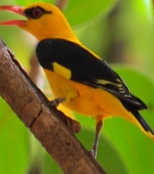
Dataset
The full dataset contains 525 unique species of birds with 100-200 images per species
The training data was reduced to 20 species with 100 images per species
The validation and test sets contain 5 image for each type of bird
Each image contains only one bird, which comprises at least 50% of the pixels
Notes:
One significant shortcoming in the data set is the ratio of male species images to female species images.
About 80% of the images are of the male and 20% of the female.
Males typical are far more diversely colored while the females of a species are typically bland.

Slide 4
Base Model Performance
Model Used | EfficeintNetB0
Weights Applied | ImageNet
Epochs Run | 5
Best Validation Accuracy | 98%
Best Validation Loss | 0.1042
Notes:
To evaluate how well a complex model would perform on our dataset, we used a pre-trained EfficentNetB0 model with ImageNet weights. After only 5 epochs the model was already predicting with 98% accuracy indicating this was a problem that would lend itself well to neural networks.

Slide 5
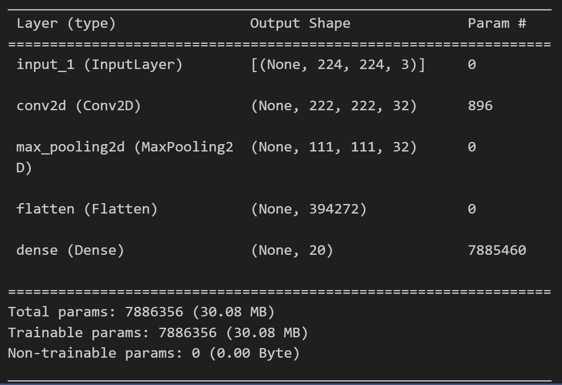
Simple Model Performance
Epochs Run | 21
Validation Accuracy | 81%
Validation Loss | 0.8571
Notes:
As a starting point, we trained a very simple model with 1 convolutional layer, a MaxPooling layer, and softmax layer.
Using early stopping, we achieved a validation accuracy of 81% and a loss of .8571 after 21 epochs.

Slide 6
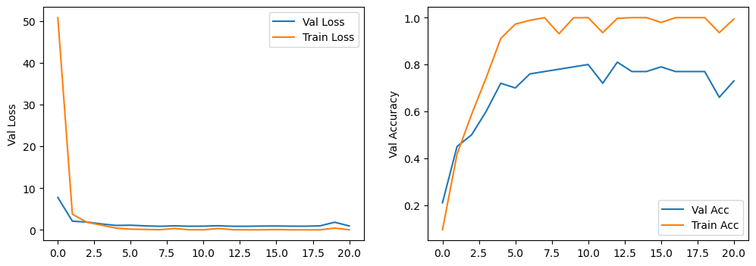
Simple Model Evaluation – Fit of Model
Notes:
After 21 Epochs, while the model had not settled completely on convergence, it was showing a tendency to overfitting.

Slide 7
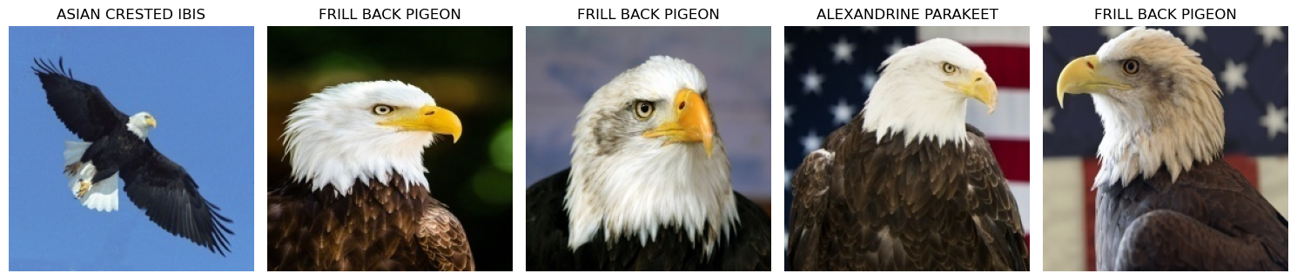
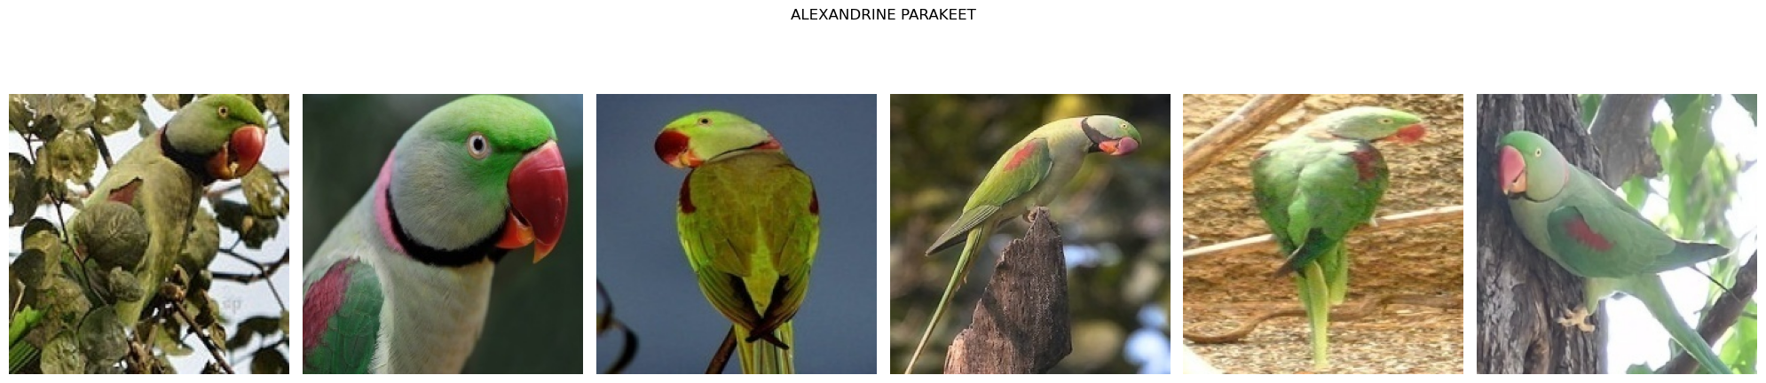
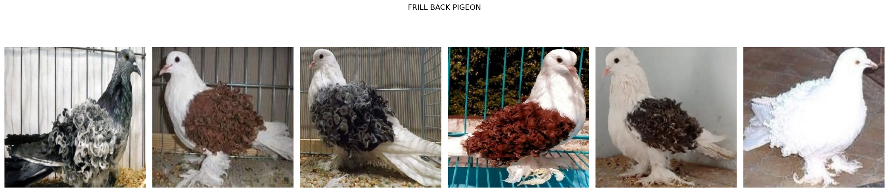
Simple Model Evaluation – Misclassified Birds
Notes:
While several classes did poorly, Bald Eagle was the worst with 0 correct classifications. Examining the birds it was confused as, some made sense such as the flying bald eagle confused for a flying ibis, and the brown and white of the eagle and pigeon being matched. Some others however were rather confusing, like the eagle being confused with a parakeet.

Slide 8
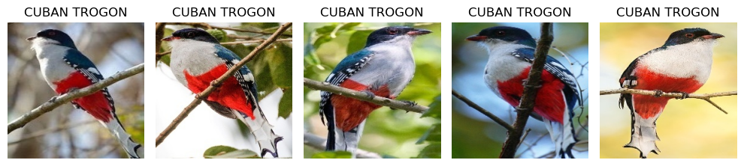
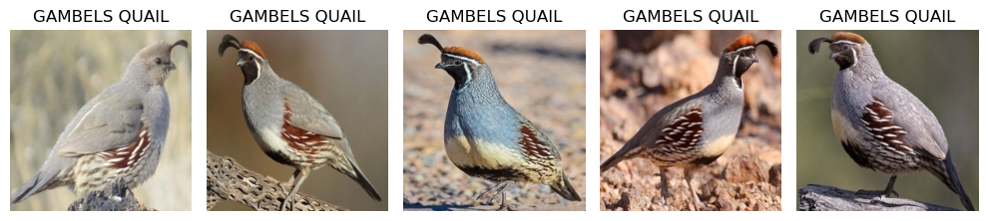
Simple Model Evaluation – Correct Birds
Good Classification
Large, colorful patches
Specific poses (i.e. flying)
Unique characteristics (Quail’s Crest)
Full bird bodies
Bad Classification
Muted Colors
Close Cropped Images
Notes:
Comparing the worst predicted classes to the best, it appeared the model was only picking out highly distinctive features. Very bright patches of color, specific poses, etc. The images that were poorly classified appeared to be of birds with very muted colors and very close up, cropped images.

Slide 9
Proposed Improvements
Increase Model Complexity
Add more CNN layers to differentiate features more
Add an additional fully connected layer to differentiate final image evaluation
Risk Evaluation
Simple model already overfitting data
Added Dropout layer to mitigate this
Notes:
Based on our evaluation, it was apparent that the model was only learning very shallow features and making its predictions on those. This worked very well for our birds that were very distinctive, but meant that the more muted birds were very poorly classified.
In order to get the model to recognize more features, we increased the complexity of our model. We added more layers to allow the model to differentiate features better, and added a second fully connected layer before the classification layer to assist with dimensionality reduction and to extract more information from the full image.

Slide 10
Complex Model Evaluation
Accuracy Dropped but no birds 100% misclassified
Model still overfitting (show plot loss)
Note that more birds classified, but followed the same pattern with color/distinct features
Discuss validation of gray scale and that quails still high but floored birds dropped

Slide 11
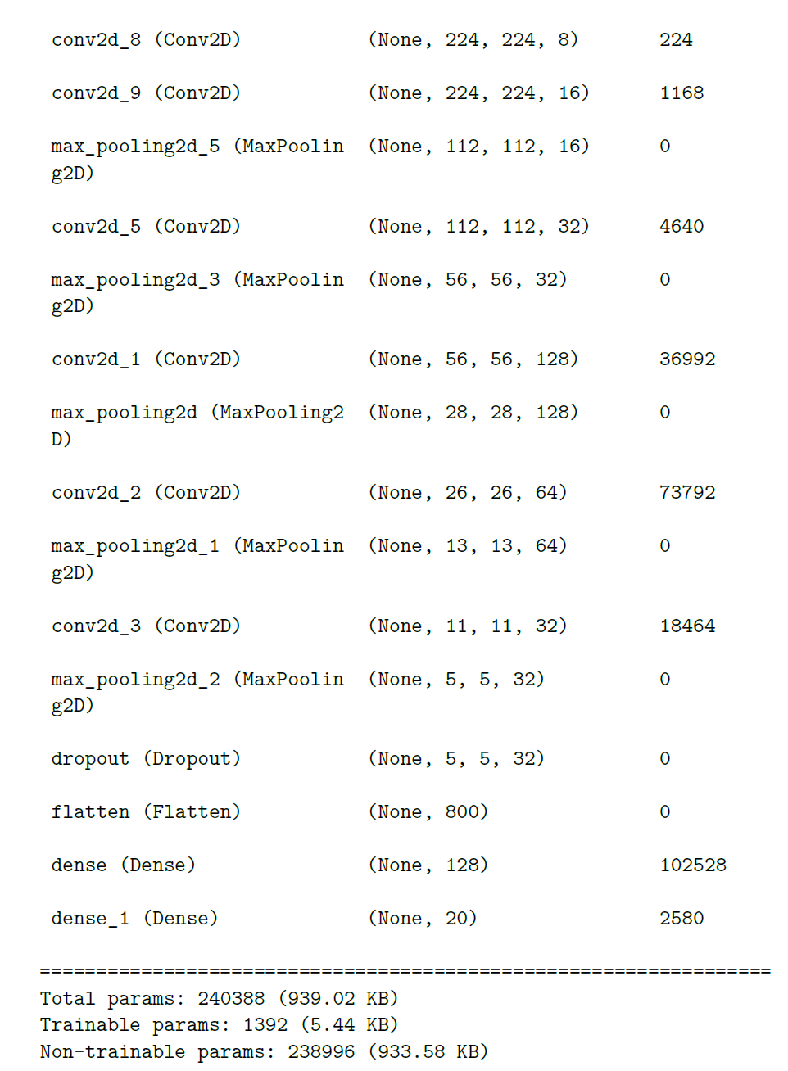
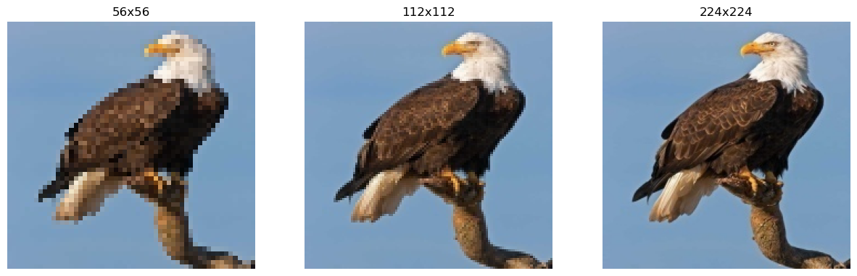
Progressive Resizing
Progressively resize images to prevent model from focusing on noise
Increase from 56x56 to 224x224
Lock weights in later layers to prevent it from retroactively learning noise
More filters in alter layers

Slide 12
Progressive Model Evaluation

Slide 13
Additional Images

Slide 14
Additional Image Evaluation

Slide 15
Conclusion

